Slide 1
Introduction to variability of flows and concentrations in watersheds using R markdown
BAE204, 30 March 2023

Slide 2
Learning objectives
Identify hydrographs and their characteristics
Identify event vs. baseflow
Calculate flow volumes
Identify chemographs and their characteristics
Calculate cumulative nutrient loads
Manipulate flow and nutrient data using R Markdown
Evaluate the importance of highflows in nutrient loads
Report findings using R Markdown

Slide 3
﻿Hydrograph

Slide 4
﻿Hydrograph

Slide 5
Characteristics of a hydrograph
An event is made of
Fast rising limb
Slower falling limb
Flow peak
Time of rise

Slide 6
Actual hydrograph over an entire year

Slide 7
Hydrographs and chemographs

Slide 8
Dilution effect

Slide 9
Concentration effect

Slide 10
Chemographs and concentration levels

Slide 11
Instantaneous loads
L = Q x C

Slide 12
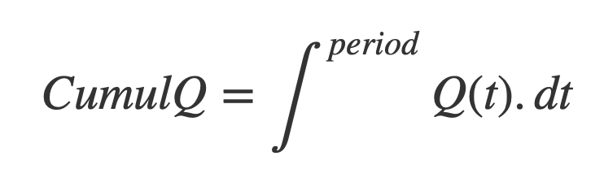
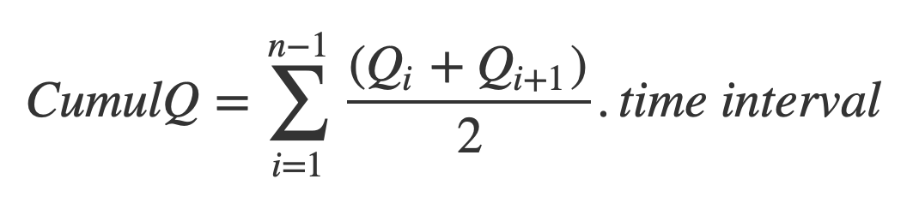
Calculating water fluxes or cumulative flow volumes

Slide 13
Calculating water fluxes or cumulative flow volumes

Slide 15
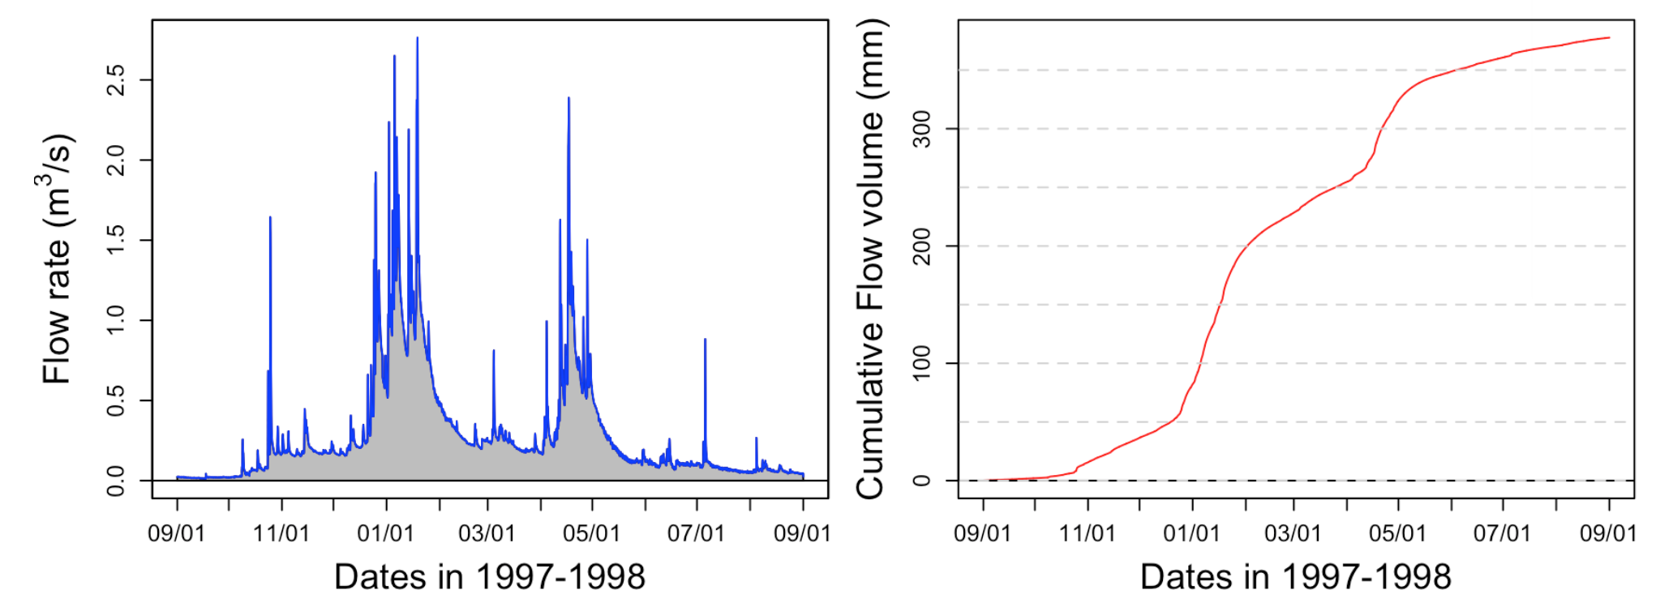
Calculating water fluxes or cumulative flow volumes

Slide 16
Volume duration curves
Evaluating the importance of rare high flow events
Flow duration curves represent the percentage of the total flow that occurred in x% of the time corresponding to the highest flows

Slide 17
Initial hydrograph

Slide 18
Sorted flow rates

Slide 19
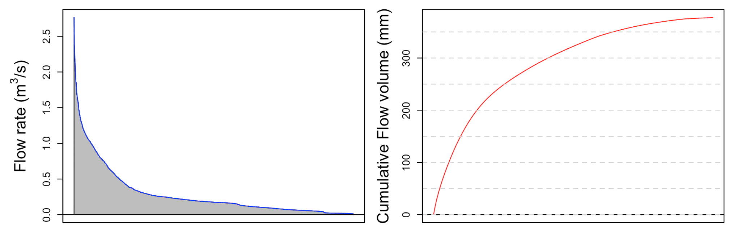
Integration under sorted flow rates

Slide 20
Flow duration curves

Slide 21
Flow duration curves
41%

Slide 22
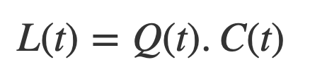
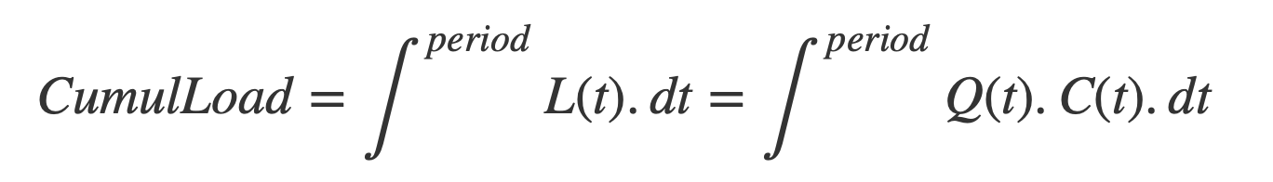
Instantaneous and Cumulative Loads

Slide 23
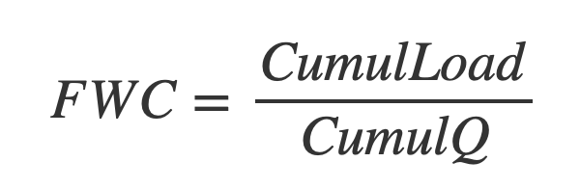
Arithmetic average vs Flow Weighted Average Concentration

Slide 24
Calculating loads without continuous concentrations
Load ~ Volume x arithmetic average
Underestimates loads when concentration effect
Overestimates loads when dilution effect

Slide 29
Arithmetic average vs Flow Weighted Average Concentration

